Slide 1

Pet Roll: A Game Project
By Ben Willcox Advisor: Dr. Manish Wadhwa ITE505 Spring 2022

Slide 2
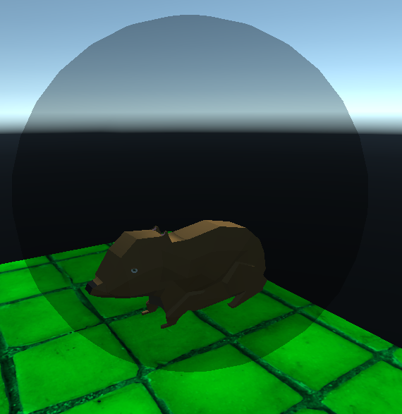
Overview
Student Objectives
Explanation of Project Change
Problem Specification
Solution Design
Tool List
Time Schedule
Grading Scheme
Demo Video
Post-mortem
Deliverables
Q&A

Slide 3
Student Objectives
Gain an understanding of Unity as a platform and its abilities and limitations
Build a foundational understanding of C#
Create an entertaining game that I can continue to improve over time

Slide 4
Project Change
Original project – grocery blockchain
Partner project with Edwin
Edwin and I were not comfortable spending the university’s money
Cost was too much of a variable
We would have to meet consistently
Not sure if we would have been able to pull that off
Opposite schedules

Slide 5
Problem Specification
Create a game based off ideas from Hamster Ball and Monkey Ball
Increase knowledge of troubleshooting code using the Web and past user experience
Figure out how to implement textures/materials, as well as:
3D modelling in Blender
Music and sounds where applicable

Slide 6
Solution Design
Started with a rolling ball and worked from there
Used copyright-free resources
Music for game
Textures + materials
3D hamster model = got help
Focused on level design that wasn’t too long/tedious
Did not want to frustrate the player if they had to restart

Slide 7
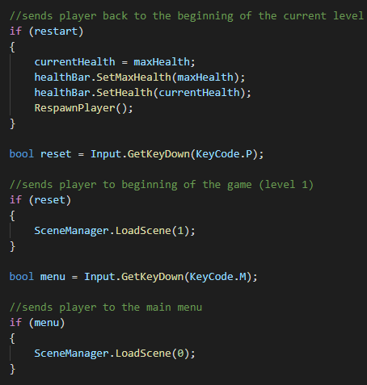

Slide 8
Tool List
Unity
ProBuilder (Unity asset package)
C#
Visual Studio Code
Blender
Audacity

Slide 9
Time Schedule
Weeks 1-3:
Bulk of model work and level design as well as player model work
Weeks 4-8:
Additional levels added as well as finding good textures. Sound design as well
Weeks 8-12:
Bringing everything together in the code. Final touches on level design as well as smaller details.
Weeks 12-14:
Focusing on documentation, project files, and report
Notes:
Week 1: (out of 14)
● Ben - create mockups for webpages
● Edwin - setup new AWS accounts and create IOT users
Week 2:
● Ben - finish mockups, and start creating the webpages.
○ Any time left will be helping Edwin with next step
● Edwin - create cloud 9 environment for both AWS accounts
○ Create and name blockchain network
Week 3:
● Create first member, set password, and add peer nodes
● Ben + Edwin will each add peer nodes individually
Week 4:
● Invite second member (Edwin)
● Vote on proposal (E + B)
● Accept invite on supplier account (Ben)
Week 5:
● Create Security groups on both accounts (Both)
● Check for any bugs or issues in the code (Both)
Week 6:
● Create VNC endpoint with private link (Edwin)
● Set sharing policy (Ben)
Week 7:
● Create the users (each account has two)
● We will both do this individually on our accounts
● Check for any bugs or issues in the code (Both)
Week 8:
● Use secrets manager to store private key material (Edwin)
● Ben will ensure everything is working along the way
Week 9:
● Set different user features using amazon cognito (Both)
Week 10:
● Create API using appsync (Both)
Week 11:
● Build Frontend (Mostly Ben)
● Edwin on backup
Week 12:
● Check for any bugs or issues in the code (Both)
Weeks 13-14: (Both)
● Make sure both accounts work properly individually

Slide 10
Grading Scheme

Slide 11
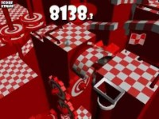

Slide 12
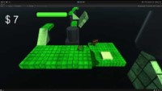

Slide 13
Post-mortem
Proud of the content I was able to implement
I was too ambitious
Thought I could get a lot more done with the time I had
Should have thought of this sooner
Would have given me more time to work on the project
In the future I would enjoy working on a game with a small team
This way each person could focus on details instead of everything

Slide 14
Deliverables
amendments to original proposal
appropriately commented source code (C#).
documentation of project functionality (final results including screenshots, some video)
user's manual
executables and/or projects
report and presentation files for ITE505
complete project journal
project post-mortem
a list of what areas of the proposal were not completed, and why
Reasons for switching projects

Slide 15
Questions

